Slide 1
École Polytechnique Fédérale de Lausanne
Università degli Studi di Genova
Homogenization of phoretic flows through micro-structured surfaces
Edoardo Carlo Giordano
Supervisors:
Prof. Alessandro Bottaro, Università di Genova
Dr. Giuseppe Antonio Zampogna, EPFL
Prof. François Gallaire, EPFL
29/03/2023

Slide 2
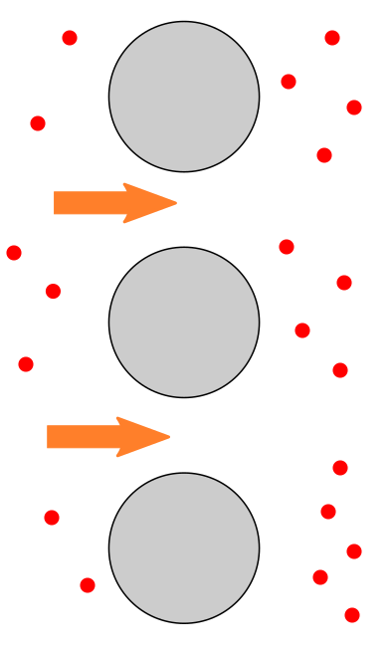
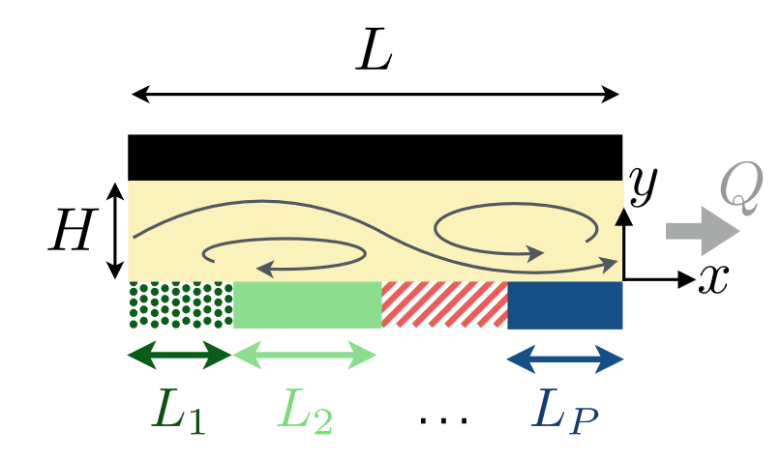
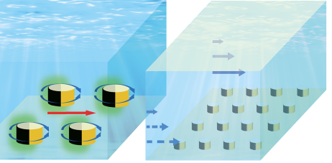
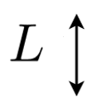
PHORETIC PUMPING
Phoresis is responsible for the migration of the particles along externally imposed solute concentration gradients.
Phoretic pumping is a method to generate flows near surfaces.
Single scale structure
Multiple scale structure
Michelin & Lauga (2019), Sci. Rep., 9(1):1-7
Tingting, Athanasios & Athanasios (2020), ACS Nano, 14, 13673-13680
… and if we consider a microscopic surface with the same properties?
2

Slide 3
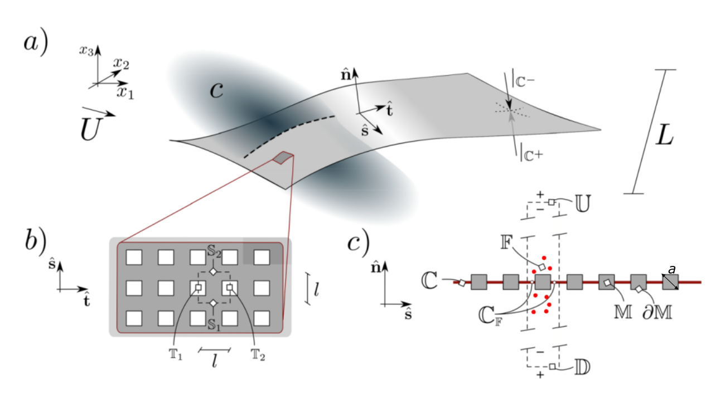
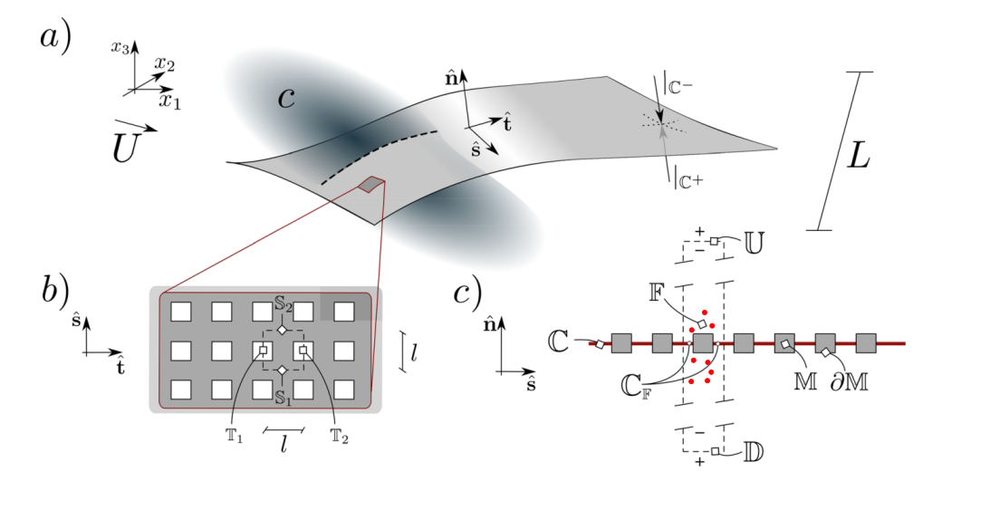
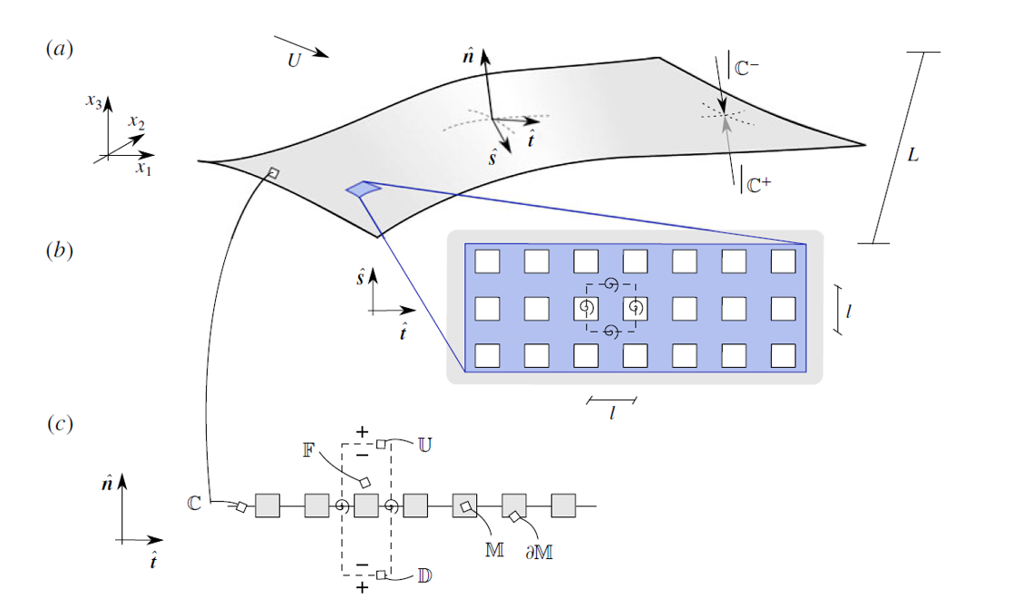
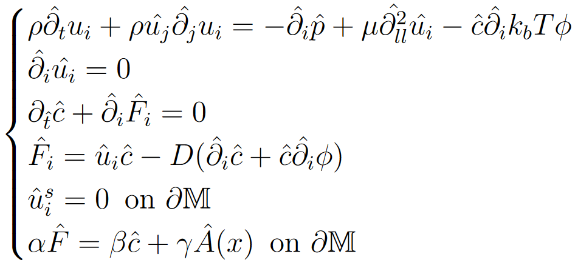
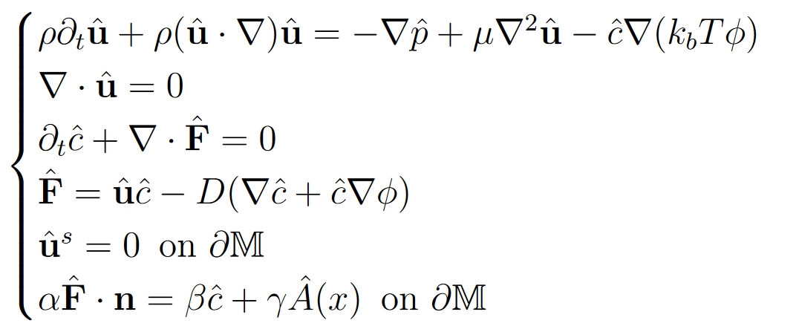
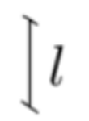
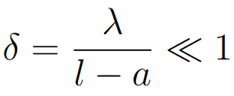
PROBLEM DEFINITION
An incompressible flow of a Newtonian fluid ($ρ,μ)$ carrying a diluted solute (c) of diffusivity D
Chemical potential with range
Short range potential
Long range potential
Michelin & Lauga (2014), J. Fluid Mech, 742:572-604
3

Slide 4
SHORT RANGE POTENTIAL
4

Slide 5
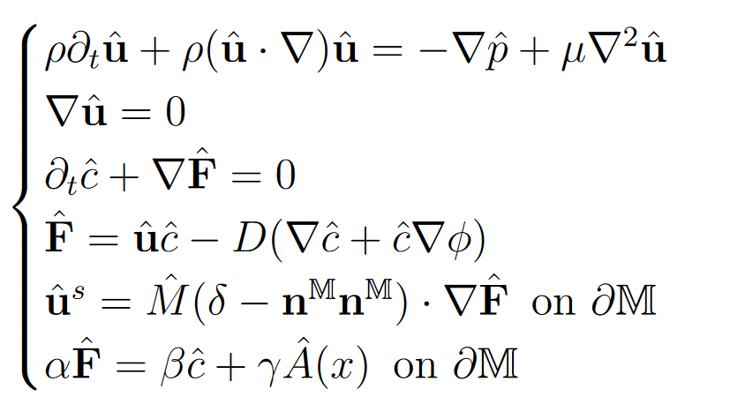
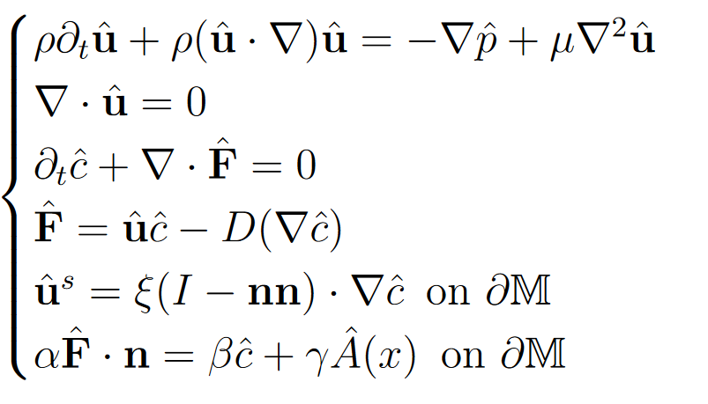
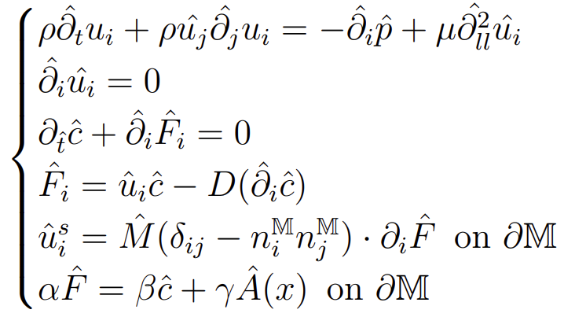
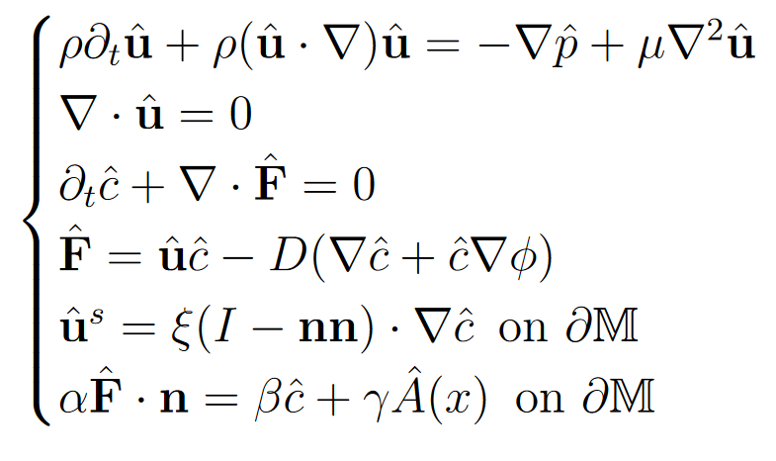
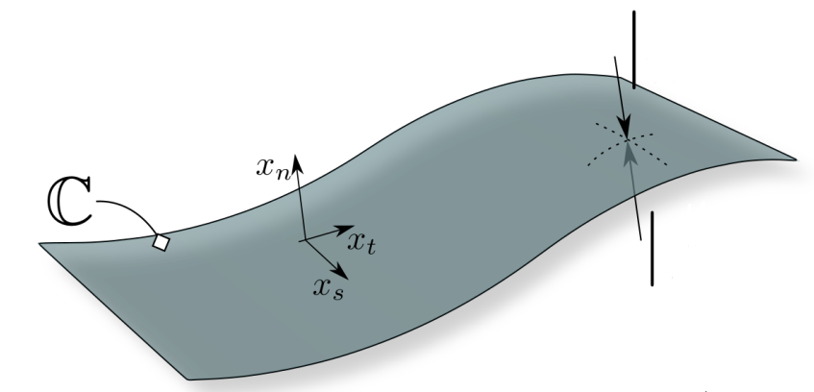
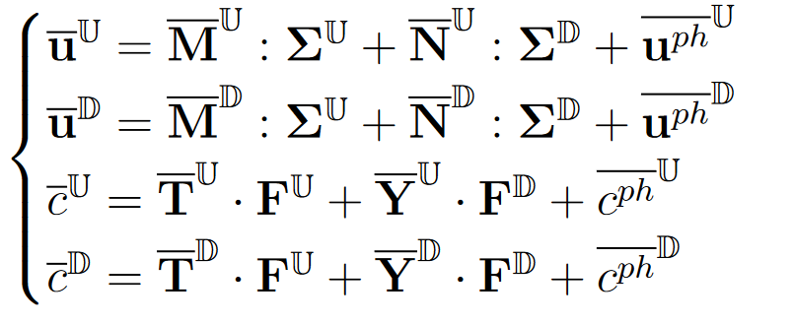
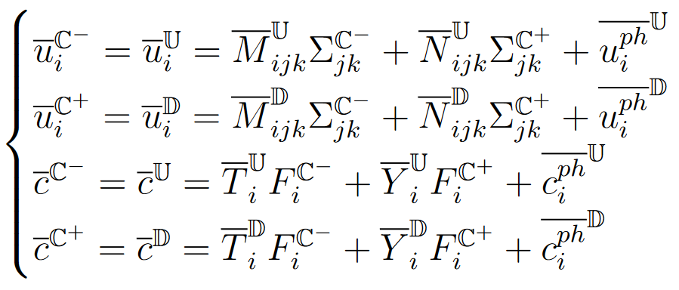
HOMOGENIZATION
Governing equations
Inner/outer scales identification
Boundary conditions inferred from outer region
Separation of scales based normalization
Modified average
Multiple scale expansion
Averaging step
Microscopic problems
Equivalent macroscopic condition
Averaging step
5

Slide 6
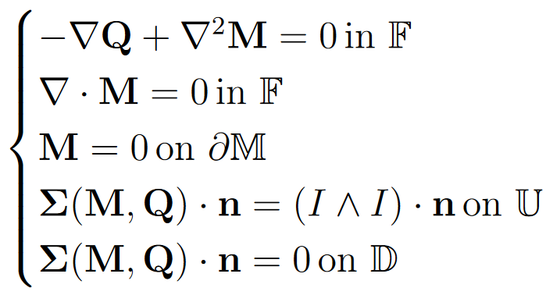
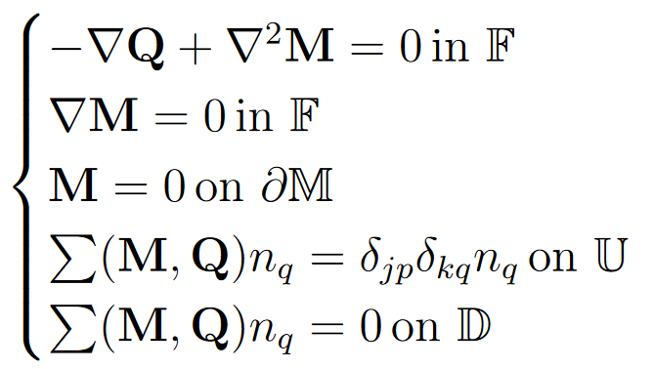
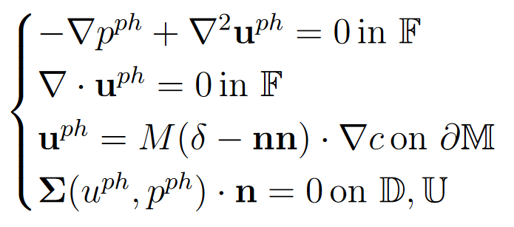
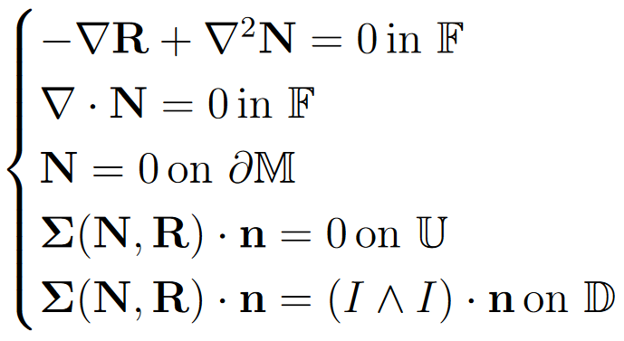
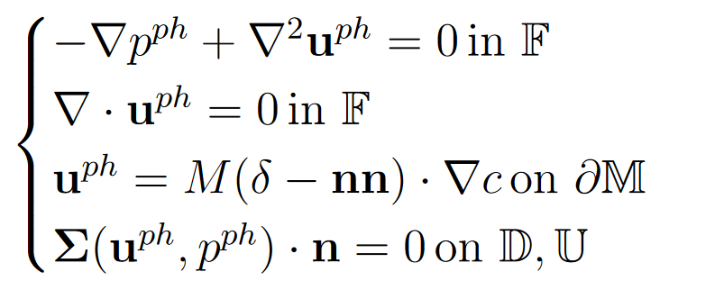
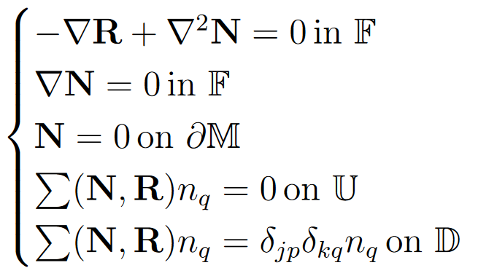
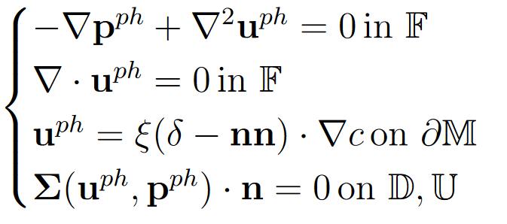
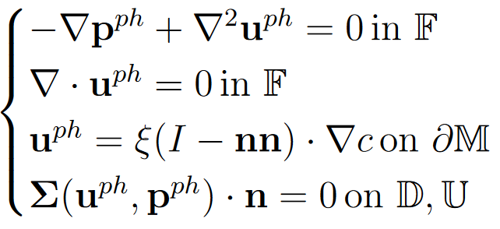
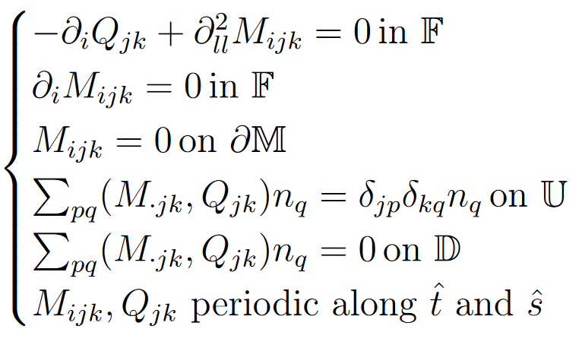
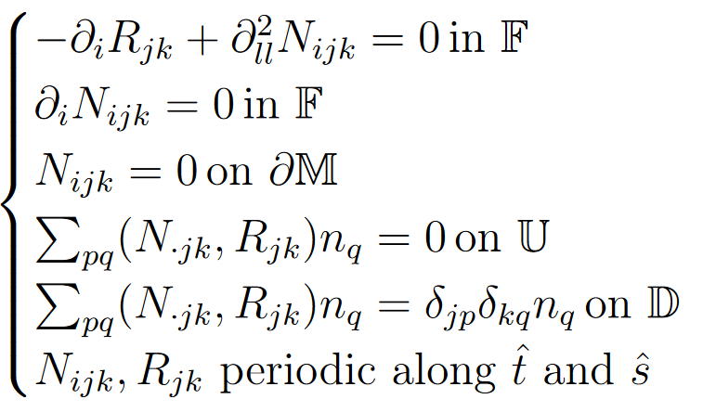
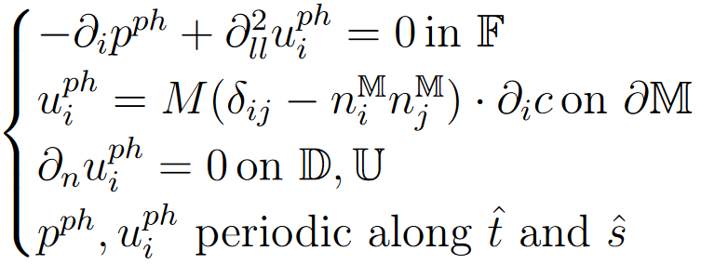
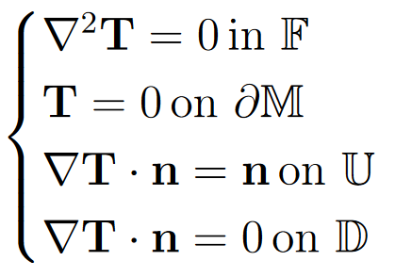
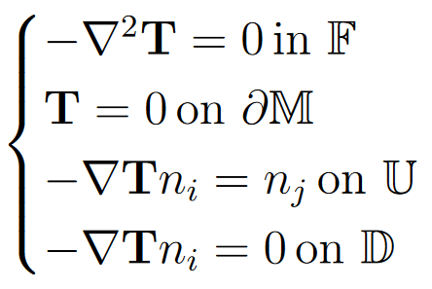
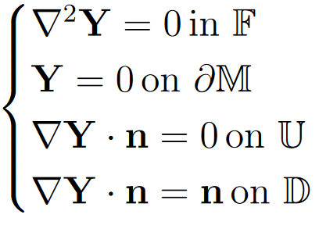
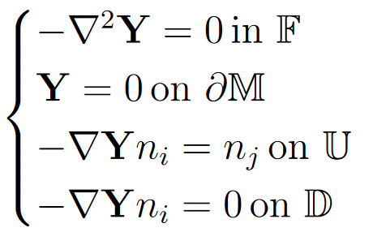
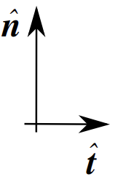
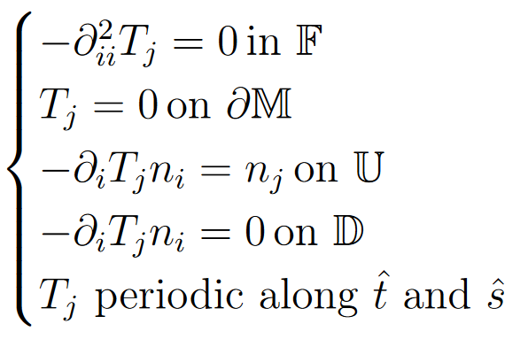
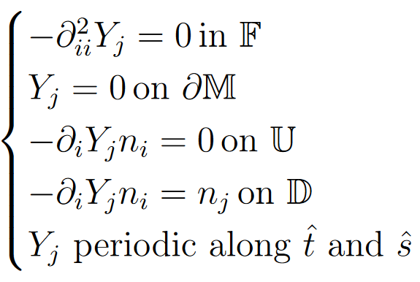
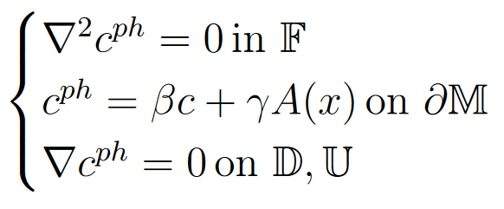
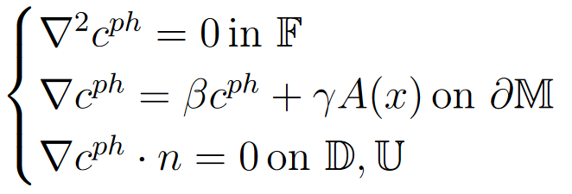
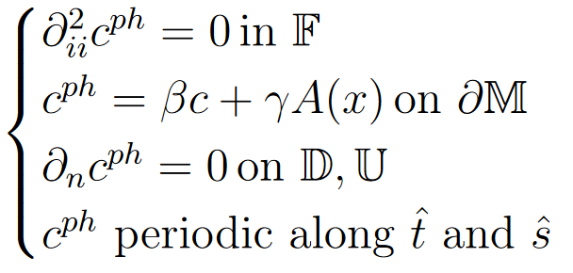
MICROSCOPIC PROBLEMS
6

Slide 7
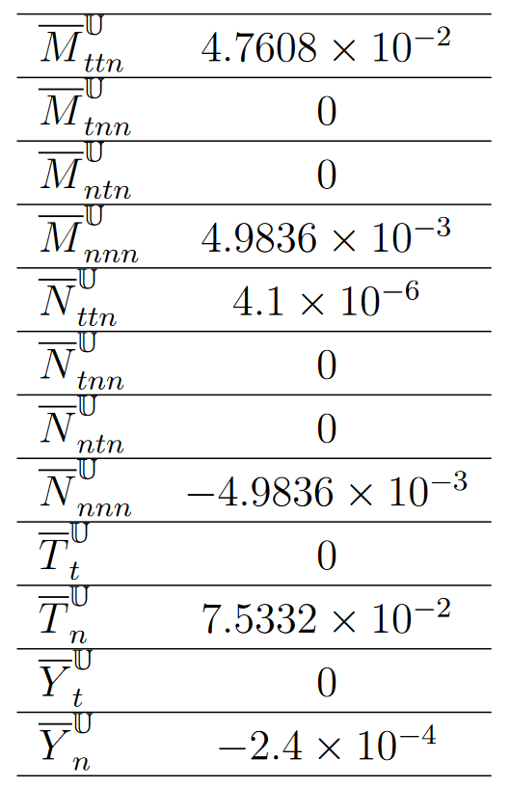
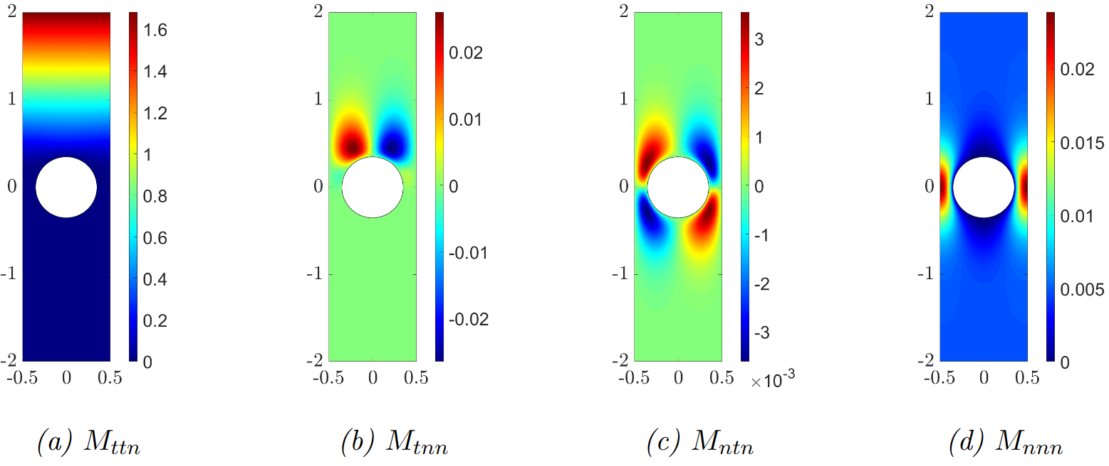
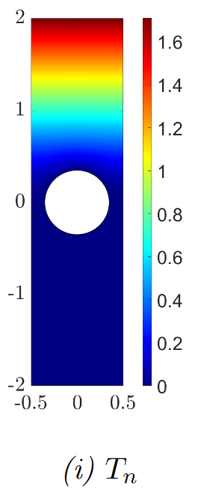
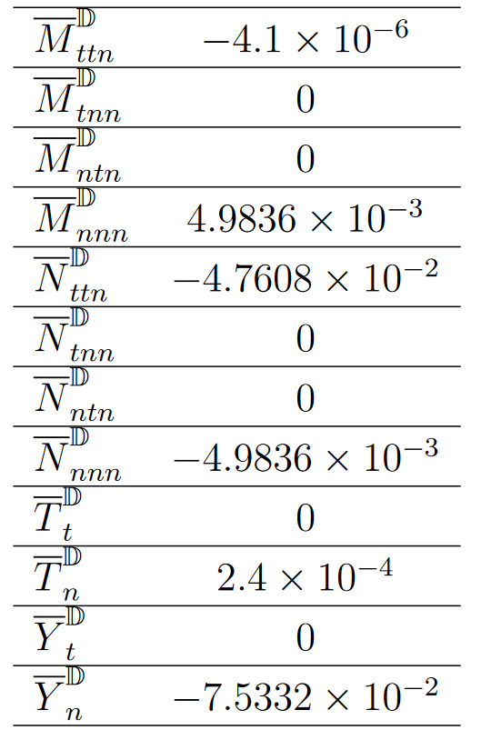
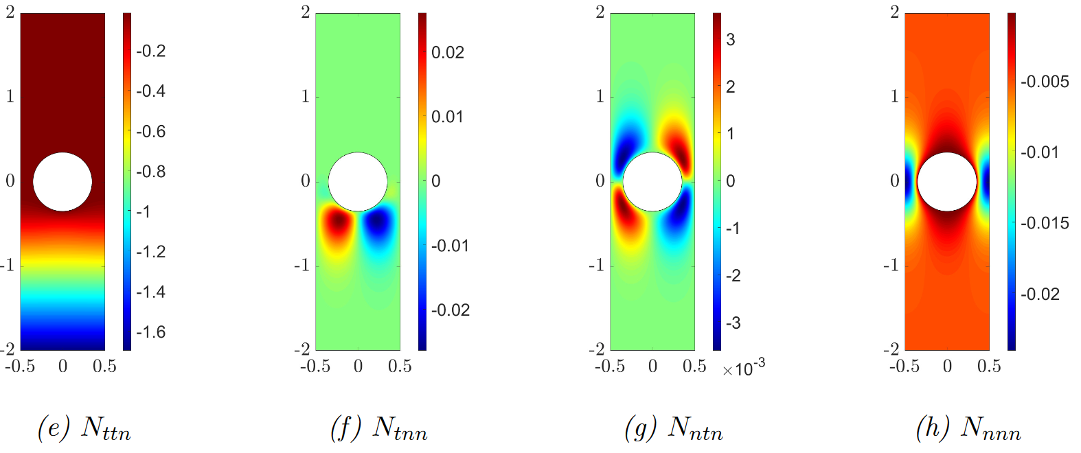
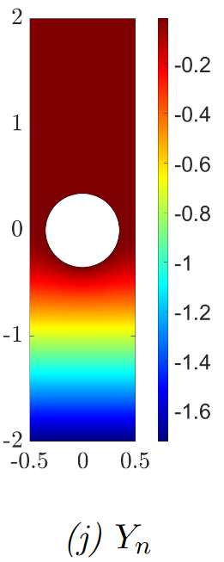
MICROSCOPIC RESULTS
7

Slide 8
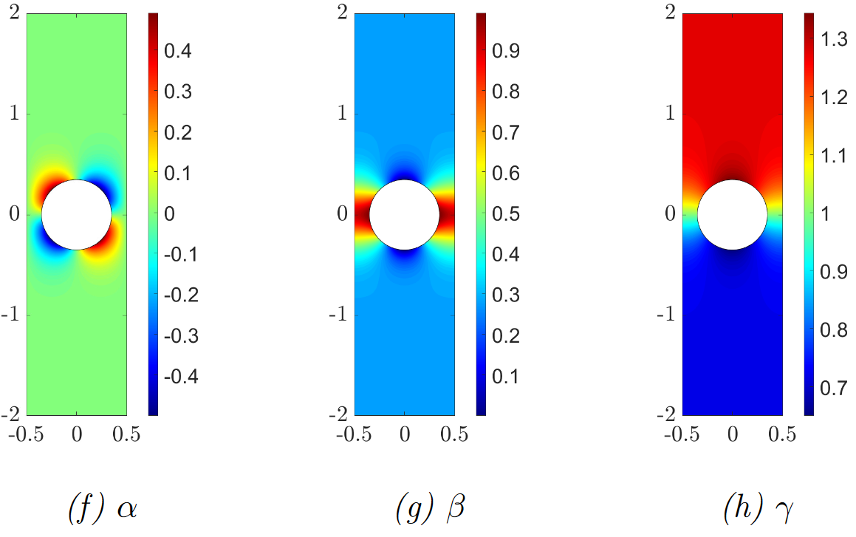
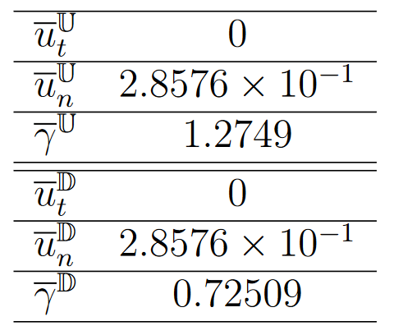
8

Slide 9
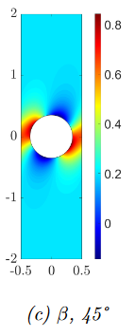
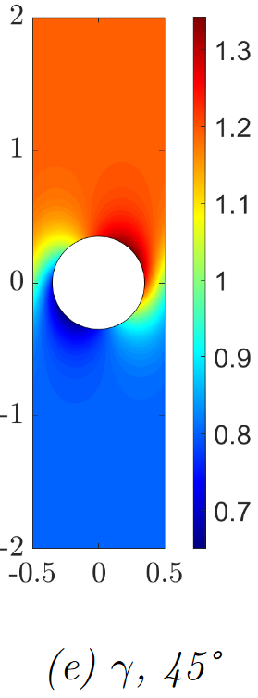
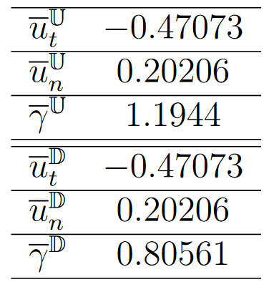
9

Slide 10
MACROSCOPIC SOLUTION

Slide 11
MACROSCOPIC SOLUTION

Slide 12
MACROSCOPIC SOLUTION
FEM implementation + domain decomposition method

Slide 13
MACROSCOPIC SOLUTION

Slide 14
MACROSCOPIC SOLUTION

Slide 15
MACROSCOPIC SOLUTION
has a constant value equal to 0 in the remaining part

Slide 16
LONG RANGE POTENTIAL
16

Slide 17
HOMOGENIZATION
Geback & Heints (2019), Trans. Porous Med.(2019), 126:161-176
17

Slide 18
HOMOGENIZATION
Geback & Heints (2019), Trans. Porous Med.(2019), 126:161-176
18

Slide 19
MICROSCOPIC PROBLEMS
+ problems for M and N as in the short range potential case
19

Slide 20
MACROSCOPIC SOLUTION

Slide 21
MACROSCOPIC SOLUTION

Slide 22
OSMOSIS

Slide 23
Future development
CONCLUSIONS
The models are purely macroscopic, they account for the presence of micro-structured via a flow constraint imposed on a smooth single-scale interface between two fluid regions.
The desired flow pattern may arise from the interplay between the macroscopic structure geometry and the microscopic properties of the inclusions forming phoretic pumps.
Application throw Electro-phoresis and electro-osmosis.
Downsize the applicability of the model to nanometric pores dimension.
23

Slide 24
THANK YOU FOR YOUR ATTENTION
24

Slide 25
MICROSCOPIC RESULTS
25

Slide 26
26

Slide 27
27

